Slide 1
Learning from
Behavior Performances vs
Abstract Behavior Descriptions
Tolga Konik
University of Michigan
Notes:
TODO: Laird ismi → LBO?

Slide 2
Goal
Automatically generate cognitive agents
Engineering Goal
  Reduce the cost of agent development
  Reduce the expertise required to develop agents.
AI Goal
  Agents that improve themselves
Notes:
These are long term motivations, not goals I want to achieve at the end of the thesis.
We will have the engineering aspect to overcome as many problems as we can, but this is a goal towards the second goal

Slide 3
Learning by Observation Approach
Approach:
  Observe expert behavior
  Learn how to replicate it
Why?
  We may want human-like agents
  In complex domains, imitating humans maybe easier than learning from scratch

Slide 4
Bottleneck in pure Learning by Observation
PROBLEM:
  You cannot observe the internal reasoning of the expert
SOLUTION:
  Ask the expert for additional information
    Goal annotations
  Use additional knowledge sources
    Task & domain knowledge

Slide 5
Two LBO Settings
Learning from Behavior
Performances
Learning from Abstract Behavior Descriptions
with J. Laird
with D. Pearson and J. Laird
Relational Learning by Observation

Slide 6
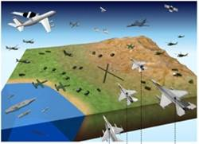
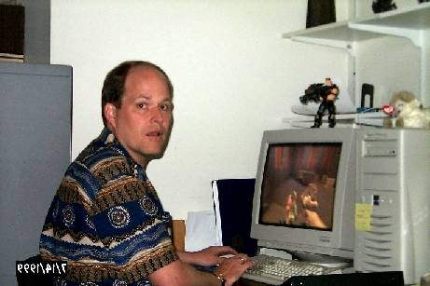
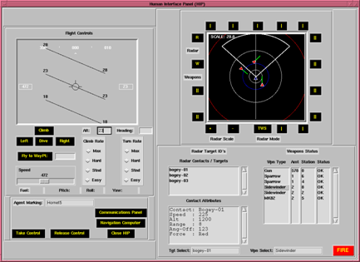
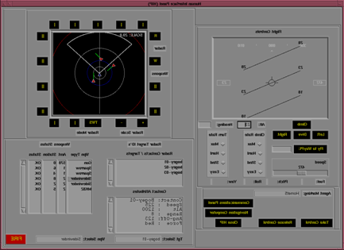
Learning from Behavior Performances
Interface
Actions
Percepts
Additional Expert Information
(i.e. Goals)
Learner
Factual and Common-sense Knowledge
Agent
Program
Notes:
Capture traces of expert behavior
What they sense
What actions they take
Induce underlying knowledge
Automatically generate programs that imitate the experts

Slide 7
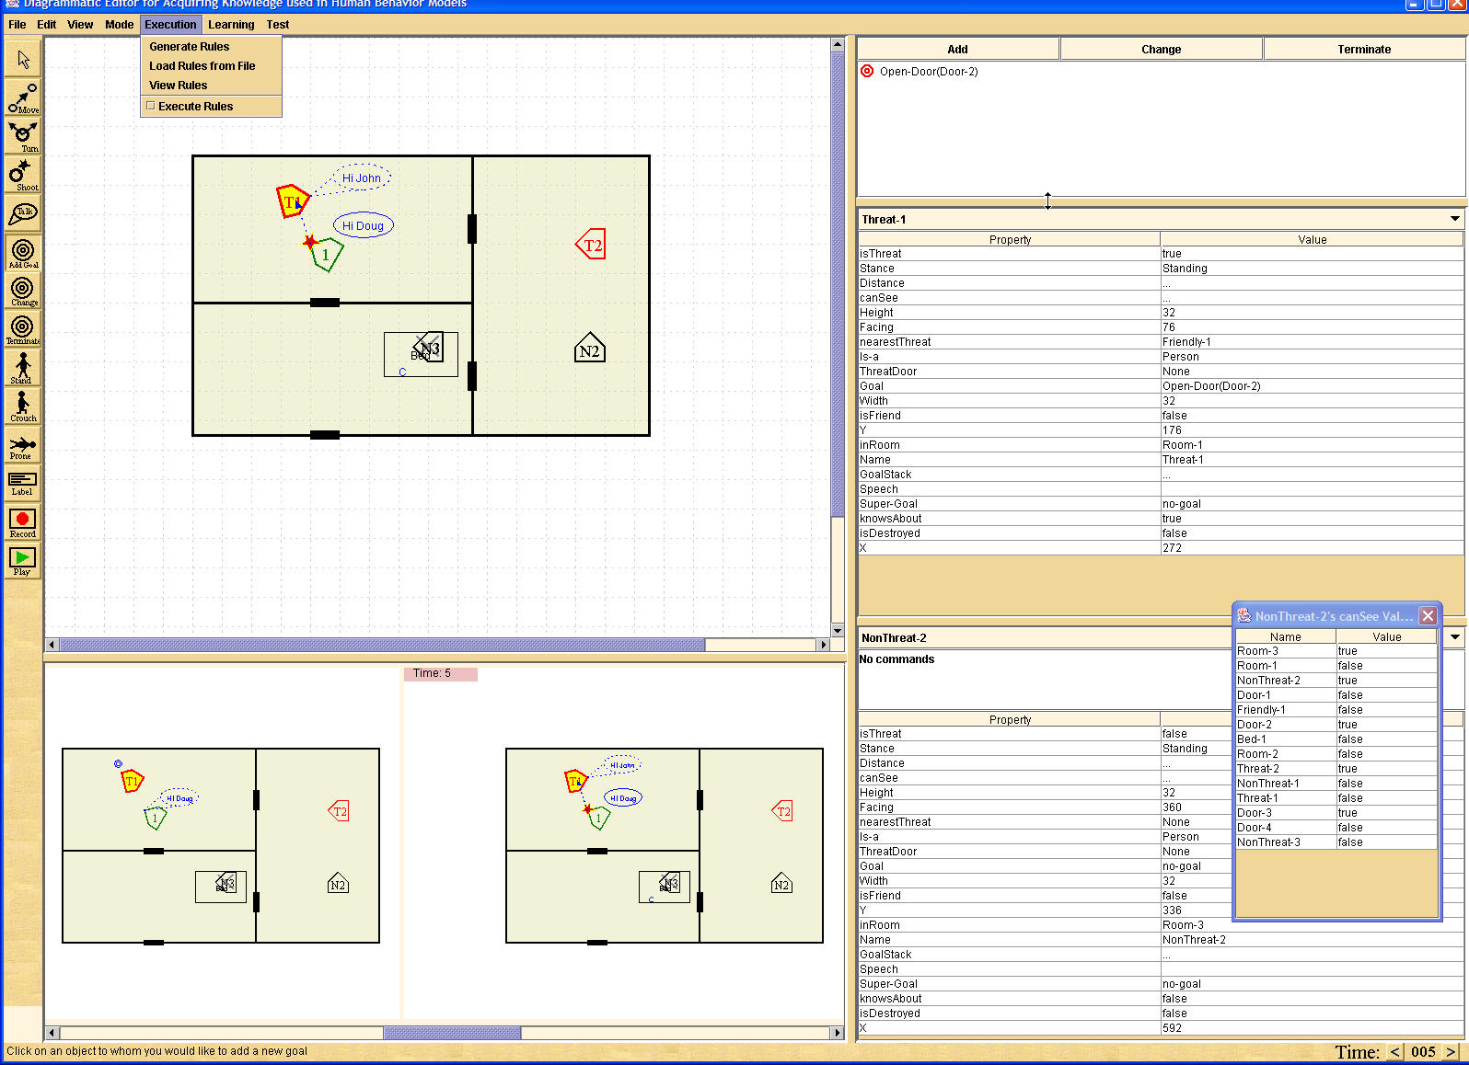
Learning from Abstract Behavior Descriptions (Redux)
Approximately learned rules
Situations
Annotations (i.e. goals, important objects, important properties)
Actions
Learner
Additional Factual and Commonsense Knowledge
Agent
Program
Notes:
Capture traces of expert behavior
What they sense
What actions they take
Induce underlying knowledge
Automatically generate programs that imitate the experts

Slide 8
Relational Learning by Observation
Behavior is the primary input
Combine knowledge from multiple sources to better interpret behavior
Use relational algorithms that use complex knowledge structures as input
ILP: Inductive Logic Programming
  Combine learning with logical reasoning

Slide 9
Relational Learning by Observation
INPUT:
  Situations: Temporally changing relations
  Expert Actions
  Expert Annotations and Meta Structures
    goals, important objects, important features, beliefs about the state of the world
  Domain Knowledge
  Explicit Bias and Constraints (i.e. goal hierarchy assumption, important objects, etc.)
OUTPUT: Agent Rules

Slide 10
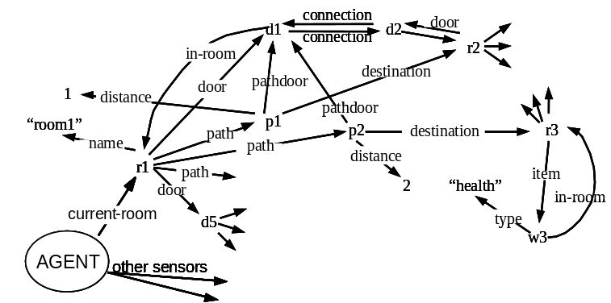
Relational Behavior Traces
Behavior Trace : The Set of Situations in execution history
A Situation:
  a symbolic snapshot of the observed environment at a time
Notes:
Situation Timeline
In practice, a situation is a decision cycle.

Slide 11
Annotated Behavior Traces
Behavior is annotated with actions and goals: goto-room(r1), etc.
Notes:
We don’t look at a single situation because we want to be able to deal with error

Slide 12

Relational Learning by Observation
Find the common structures in the decision examples

Slide 13
Relational Learning by Observation
?

Slide 14
Relational Learning by Observation
Learn relations between what the agent wants, perceives and knows.
?
“Select a door in the current room, which leads to a room that contains the item the agent wants to get”

Slide 15
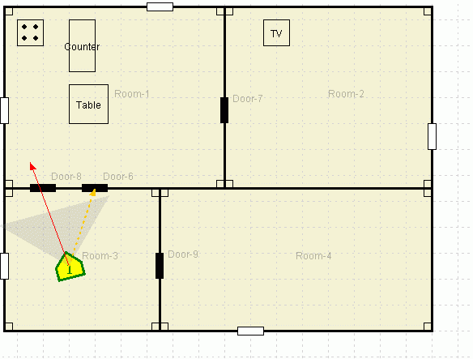
Add’l Redux Knowledge Capabilities
#1: Hypothetical Behavior
Hypothetical Actions and Goals
  Situation history : a tree structure of possible behaviors

Slide 16
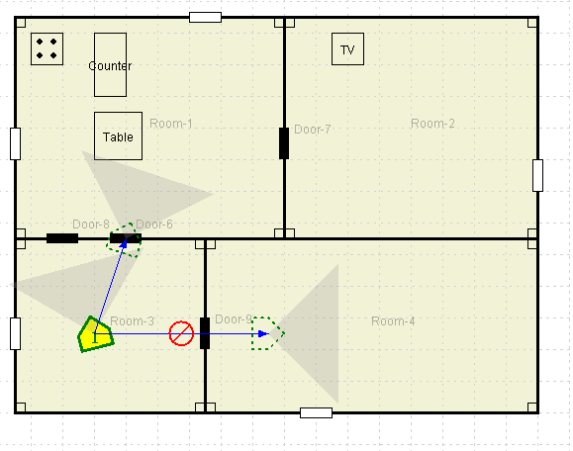
Add’l Redux Knowledge Capabilities
#2: Rejected Behavior
Can indicate undesired Actions and Goals
Can reject actions and goals of the approximately learned agent program
Watch TV

Slide 17
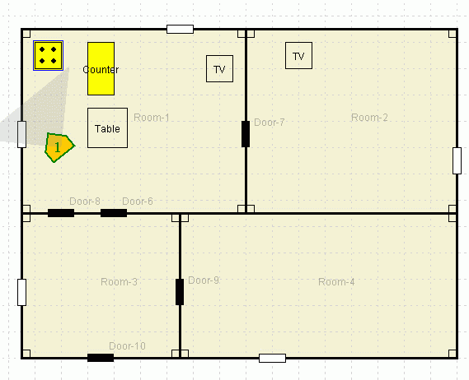
Add’l Redux Knowledge Capabilities
#3: Meta Annotations
Expert can mark important objects in a decision
Prepare food

Slide 18
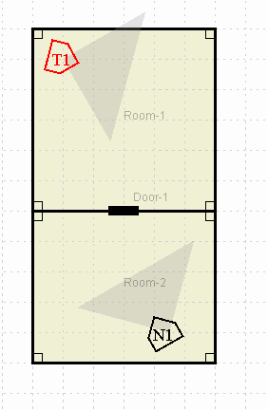
Add’l Redux Knowledge Capabilities
#4: World State Assumptions
The expert may communicate internal assumptions and beliefs about the unobservable parts of the environment.
If you assume T1 is in the next room, go towards Door1.
Going to T1

Slide 19
Add’l Redux Knowledge Capabilities
#5: Internal Knowledge Structures
Expert can describe knowledge structures the agent has to build
  i.e. marking a room and annotating it as “already searched”
Can be learned similarly to regular actions:
  “knowledge actions”
Not implemented yet

Slide 20
Comparing Redux to LBO
Advantages of Redux
No real time constraints on behavior
  i.e. no waiting for a 2 hour long goal
  can be used to describe unlikely, but critical situations
    i.e. “Let’s assume that there is a nuclear melt-down.”
Richer annotation opportunities
  Increase learning speed and quality
Faster focus where knowledge is lacked most
  Immediate expert feedback on how rules behave

Slide 21
Comparing Redux to LBO
Disadvantages of Redux
Can’t learn low level behavior.
Must contain domain specific components
  Although most of Redux is domain independent
Generating behavior may be slower.
Additional annotations improve learning but require extra expert effort

Slide 22
Nuggets
  Two complementary methods utilizing all available information sources in a unified learning framework.
  Experimental results both in Redux, and real behavior performance in the Haunt domain
  Learning converges to the correct hypothesis with a small number of examples (but not fast)
Coals
  The current ILP algorithms we use are not fast enough for interactive learning.

